Slide 1
T1S Autoconfiguration Tooling
Martin Ruppert

Slide 2
Motivation
To give us ESE a learning curve in
T1S Technology
C and Pyhton Coding
Project Working
git and Github
MDB Core
Soft- and Hardware Testing
This project is not about creating a Software Engineering Company within the Microchip Sales Organization. It is about to learn the processes, structures and vocabulary that our customer are dealing with
All items in the list above could be used in total different customer support processes
And maybe another result could be a proof of concept for customers in the industrial area for an T1S autoconfiguration scenario

Slide 3
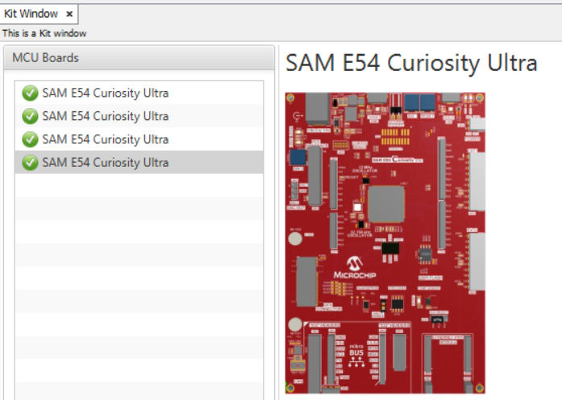
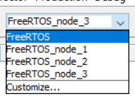
Motivation
When you have four T1S Nodes, you need 4 Evalkits and 4 different HEX files.
With conditional compiling you can have one project with four configuration
But allways compile four times a project and programming afterwards four board
Can be confusing and time consuming. How can this be done easier?

Slide 4
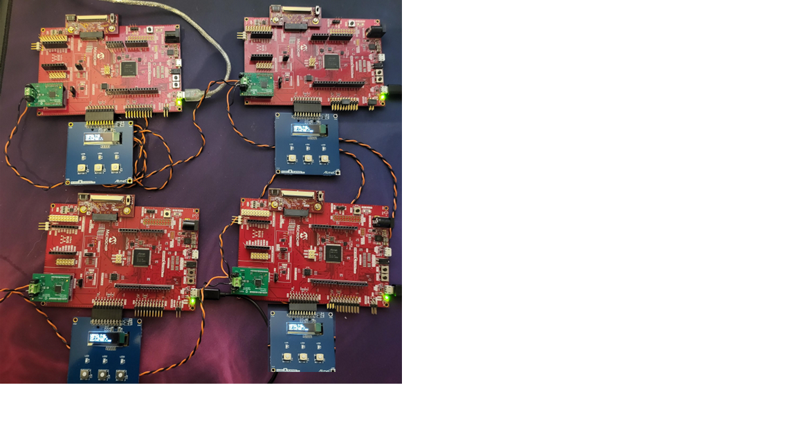
GOAL
One Firmeware for all boards
Communication between boards should be visible in the OLED1 Extension
Demo should be controlable with only the OLED1 Extension
More complex operations can be done via a terminal

Slide 5
T1S auto config test assembly
SAME54 Curiosity
T1S PHY Daughter Board
OLED1 Xplained Extension
PHY 8670
PHY 8670
Same54
STP Cable for T1S Communication
Same54
OLED
OLED
PHY 8670
PHY 8670
Same54
Same54
OLED
OLED

Slide 6
Github Project
The whole project inclusive all Pyhton Codes and the Presentation is hosted on github at
https://github.com/Bolderain/T1S_Autoconf
It is a Fork of
https://github.com/Microchip-MPLAB-Harmony/net_10base_t1s.git
from version v1.3.0
The target is to make it official available at https://github.com/MicrochipTech

Slide 7
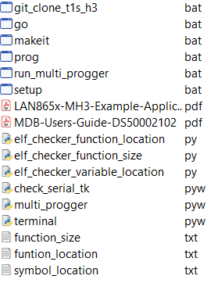
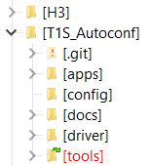
Cloning the Framework with «one click»
The script git_clone_t1s_h3.bat clones all neccessary Harmony repositories in the directory H3 (one directory level higher)
You can adjust the Framework Installation path in the In the script with
set H3_INSTALL="../../H3"
For beeing able to generate and and modify the T1S applications of version v1.3.0 with the MCC.
Call it from /tools

Slide 8
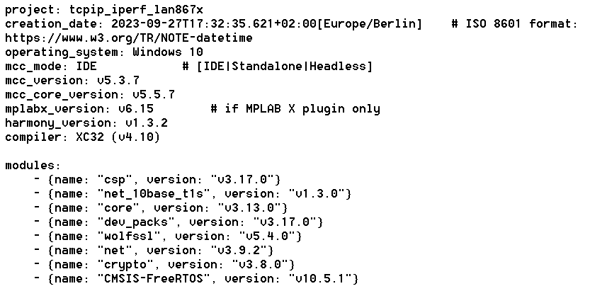
Cloning the Framework with «one click»
This git_clone_t1s_h3.bat clones several Harmony Repositories and checkout the needed versions. The neccessary Repositories and versions are derived from the projecta Manifest File „harmony-manifest-success.yml“
@ECHO OFF
set H3_GITHUB="https://github.com/Microchip-MPLAB-Harmony"
set H3_INSTALL="../../H3"
git clone -b "v10.5.1" https://github.com/ARM-software/CMSIS-FreeRTOS.git %H3_INSTALL%/CMSIS-FreeRTOS
git clone -b "v3.17.0" %H3_GITHUB%/csp.git %H3_INSTALL%/csp
git clone -b "v3.13.0" %H3_GITHUB%/core.git %H3_INSTALL%/core
git clone -b "v3.17.0" %H3_GITHUB%/dev_packs.git %H3_INSTALL%/dev_packs
git clone -b "v5.4.0" %H3_GITHUB%/wolfssl.git %H3_INSTALL%/wolfssl
git clone -b "v3.9.2" %H3_GITHUB%/net.git %H3_INSTALL%/net
git clone -b "v3.8.0" %H3_GITHUB%/crypto.git %H3_INSTALL%/crypto
git clone -b "v1.1.0" %H3_GITHUB%/devices.git %H3_INSTALL%/Devices
git clone -b "v1.3.0" %H3_GITHUB%/net_10base_t1s.git %H3_INSTALL%/net_10base_t1s
git clone %H3_GITHUB%/devices.git %H3_INSTALL%/devices
pause
@ECHO ON

Slide 9
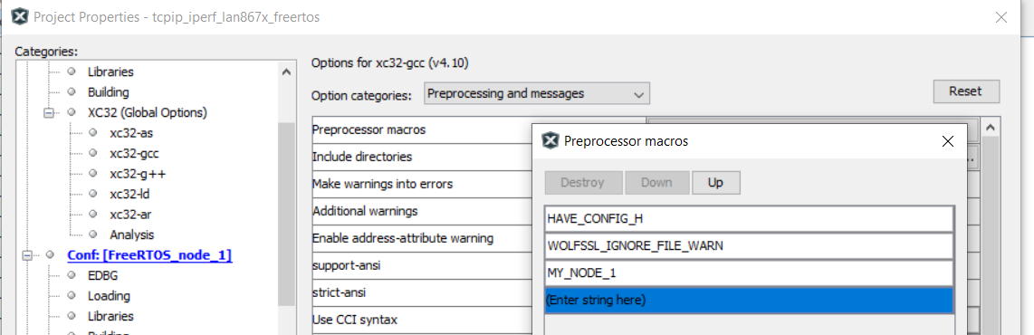
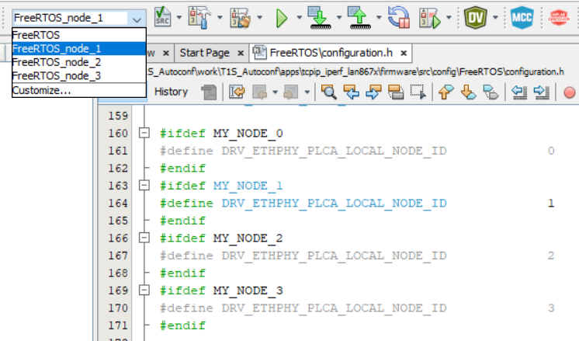
Conditional Compilation through Predefined Symbols
This allows to have one project for 4 different boards.
Every board do need a different MAC, IP, NodeID

Slide 10
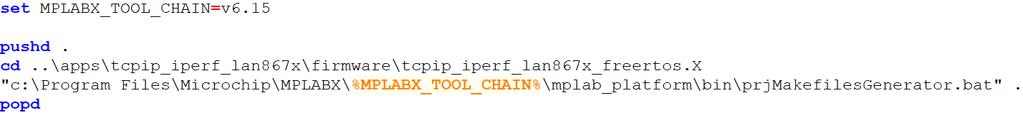
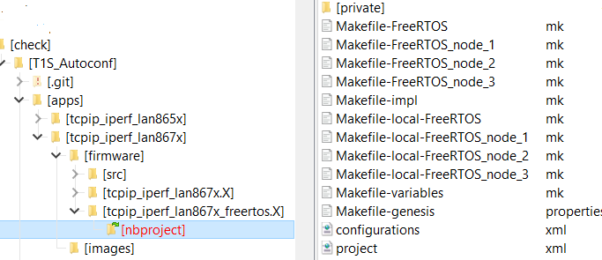
Generate Makefiles
The script setup.bat calls the „prjMakefilesGenerator.bat“
i.e. It creates all Makefiles. This is normally done by MPLABX when the project is opened. And allows to build the projects without using MPLABX
If another MPLABX Version should be used than v6.15, this must be changed in the script

Slide 11
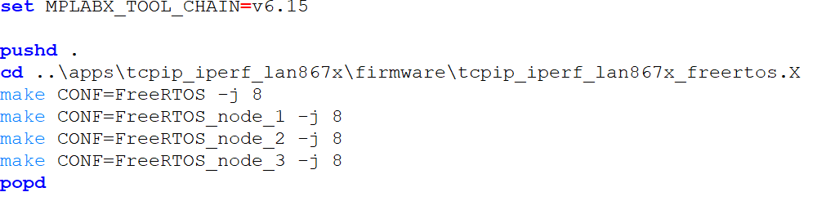
Build all configurations
If another MPLABX Version should be used than v6.15, this must be changed in the script
The script „makeit.bat“ call the make utility to build all configuration on the command line

Slide 12
Programming 4 Boards at the same time
If another MPLABX Version should be used than v6.15, this must be changed in the script
The Tool „multi_progger.pyw“ is a Python Tkinter GUI that controlls 4 instances of the MDB Core simultary.
This allows to keep the connection to four MDB‘s instances and programming four controller at the same time.

Slide 13
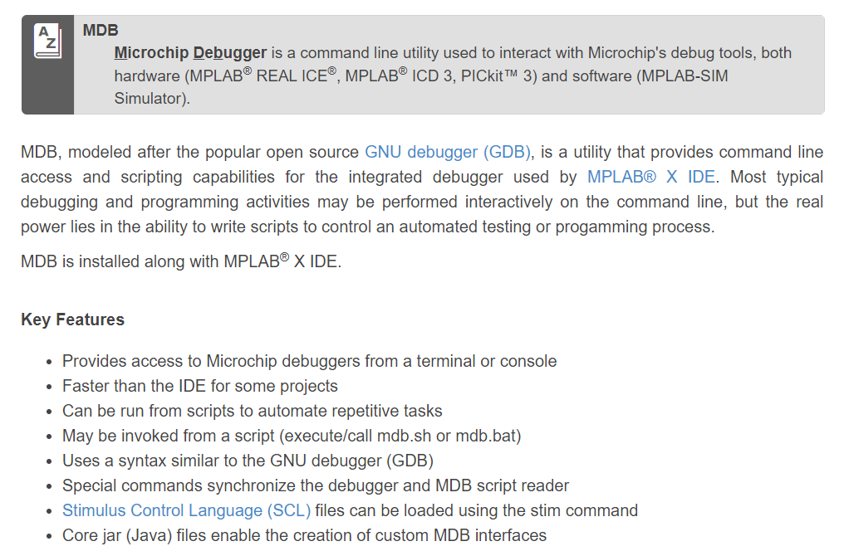
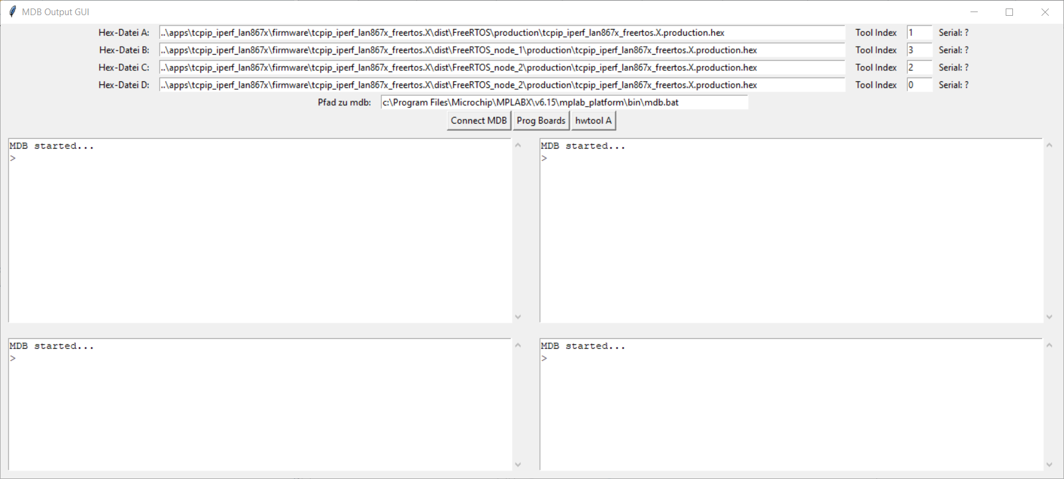
Python GUI for parallel Programming with MDB
The Pyhton Script starts MDB.bat as a Sub-Process and controlls the input and output. This allows a „remote control“ of the MDB.bat
More Information about the MDB and how to use it at: https://microchipdeveloper.com/mplabx:mdb

Slide 14
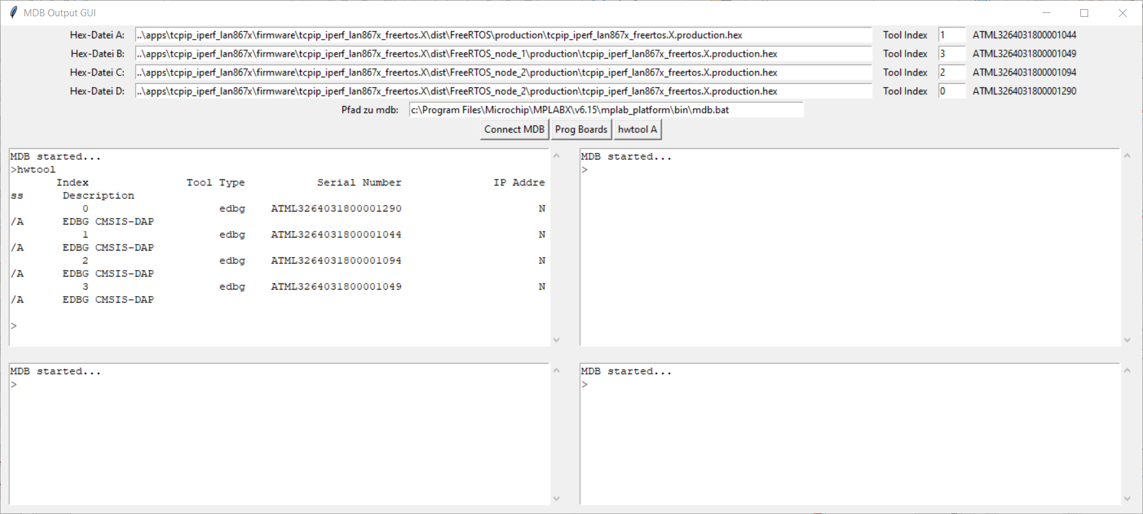
Python GUI for parallel Programming with MDB
„hwtool“ is a MDB command that lists all available debuggers and assigns them an index number. This index number is used to select the debugger
By changing the index number, a debugger can be specifically assigned to a window

Slide 15
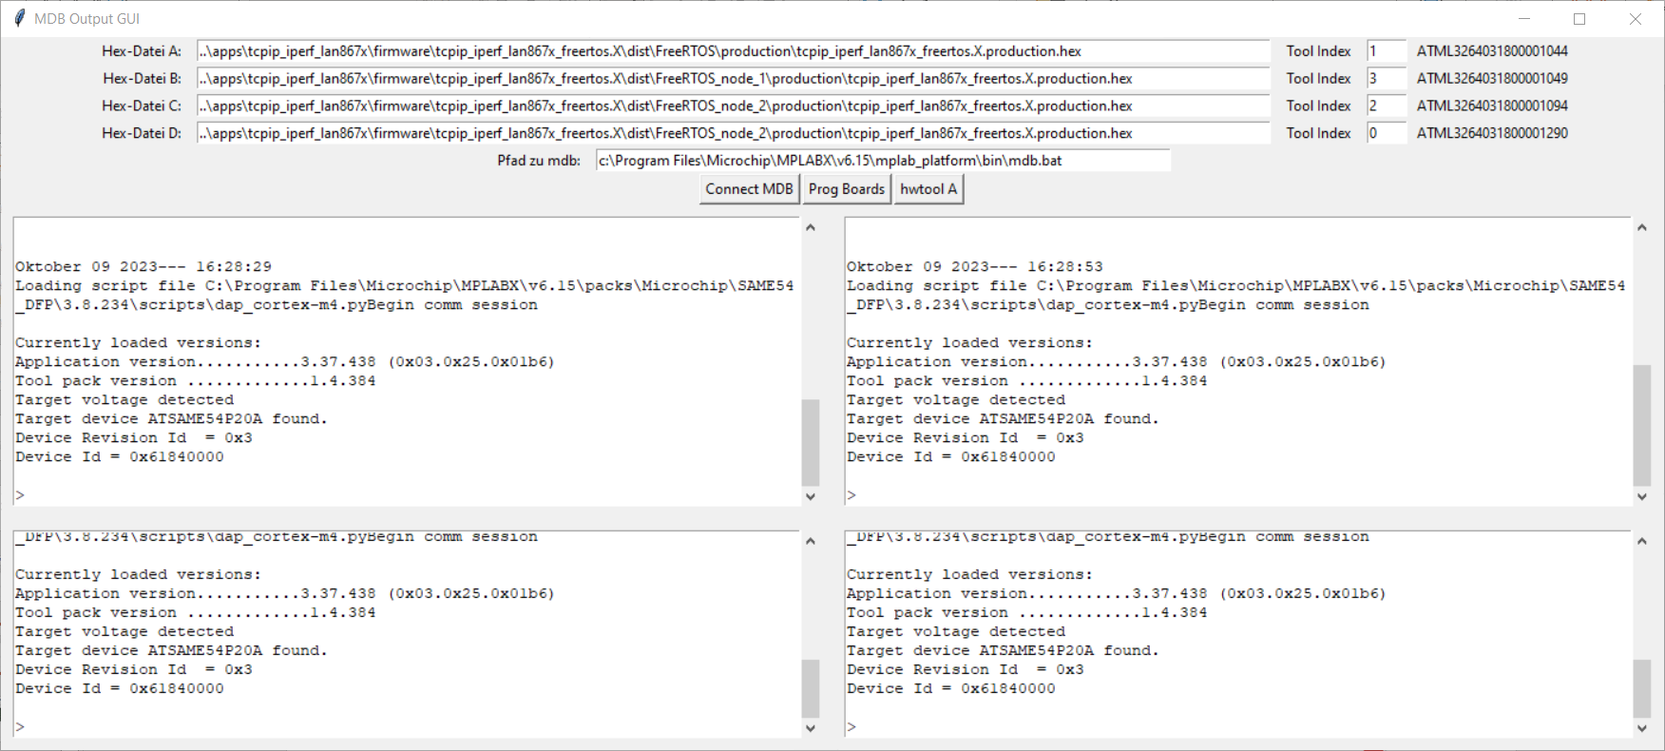
Python GUI for parallel Programming with MDB
With clicking on „Connect MDB“, all setup is done for EDGB, Speed 6Mbit, SWD Interface and selecting the debuggers. This takes some time until it‘s connected
Keep in mind that every mdb.bat process do need about 2 Gbyte of RAM. All four instancess are around 8 Gbyte of RAM

Slide 16
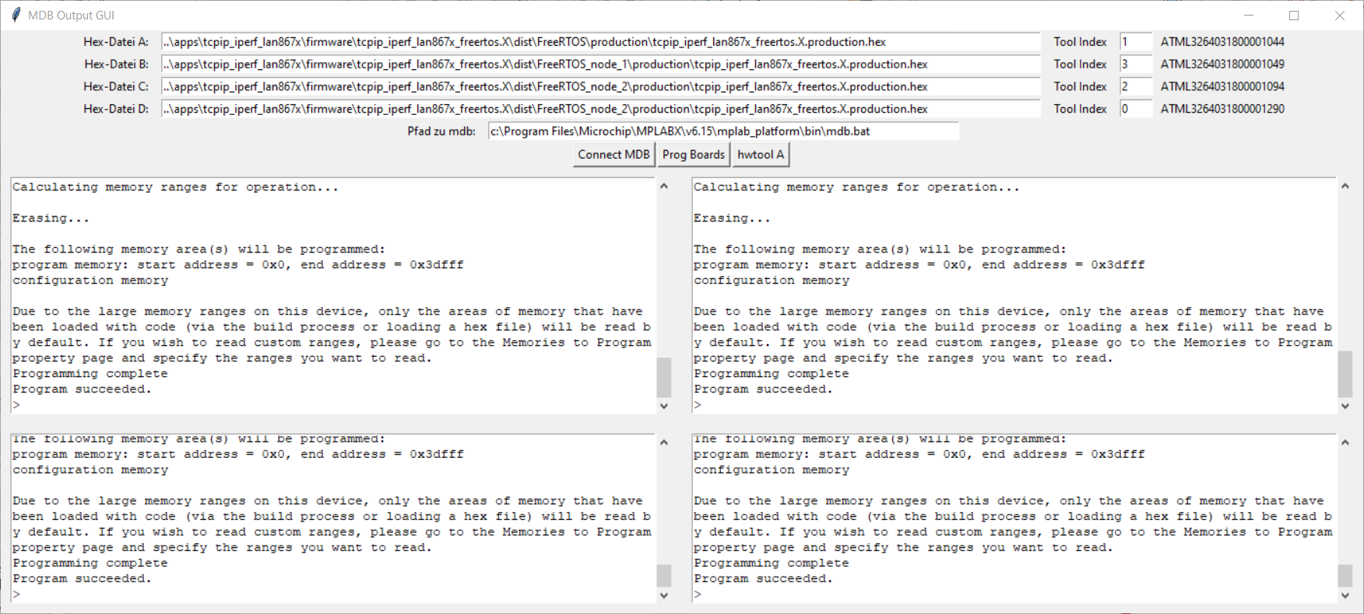
Python GUI for parallel Programming with MDB
“Prog Boards” programs all Hex files in parallel. The connection to the debugger is maintained so it is not necessary to re-establish the connection again. This allows the programming process to start more quickly.

Slide 17
Python GUI for testing 4 Boards in parallel
„terminal.pyw“ is the Terminal program that talks with 4 Boards at the same time.
The idea came to me when I was once again completely annoyed by having to arrange TerraTerm four times on my desktop and assigning them to the corresponding COM ports

Slide 18
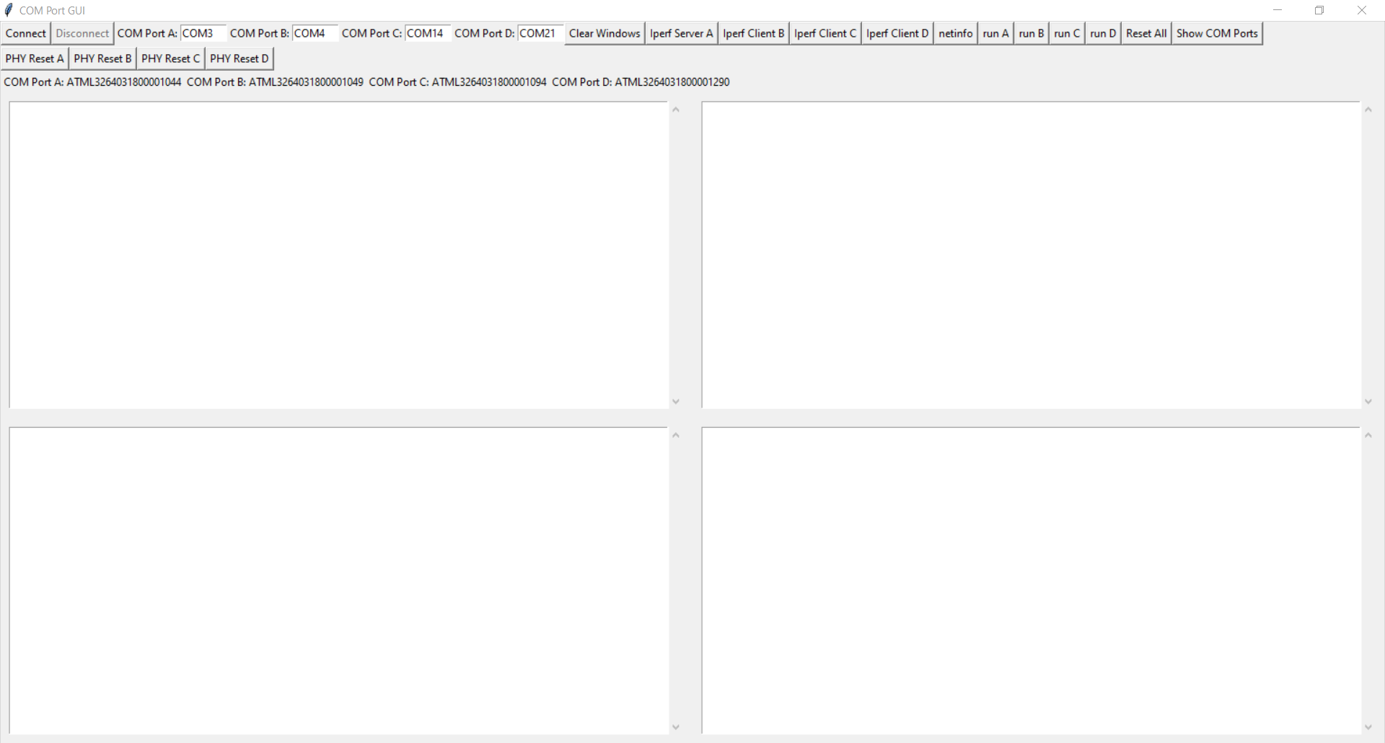
Python GUI for testing 4 Boards in parallel
This tool is basically a 4-way Comport Terminal.
There are 4 default COM ports in the upper left, which must be changed to the ones on your machine.
If a COM Port entry is left free, this COM port is not used, so that this tool can be used with less than 4 boards

Slide 19

Python Modules Dependencies „terminal.pyw“
pip install pyserial
https://pythonhosted.org/pyserial/index.html
This module encapsulates the access for the serial port. It provides backends for Python running on Windows, OSX, Linux, BSD (possibly any POSIX compliant system) and IronPython. The module named “serial” automatically selects the appropriate backend.

Slide 20

Python Modules Dependencies „terminal.pyw“
pip install matplotlib
https://matplotlib.org/
Matplotlib is a comprehensive library for creating static, animated, and interactive visualizations in Python. Matplotlib makes easy things easy and hard things possible.

Slide 21
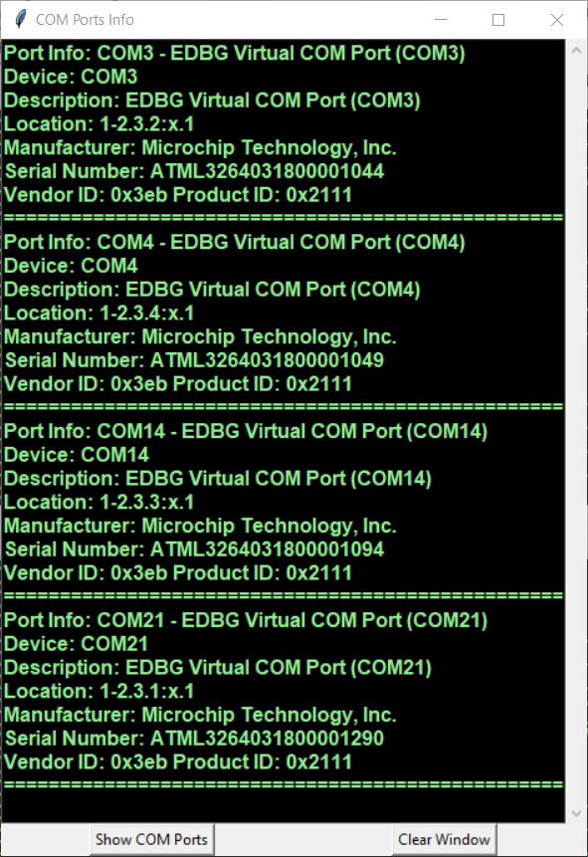
Python GUI for testing 4 Boards in parallel
A
B
C
D

Slide 22
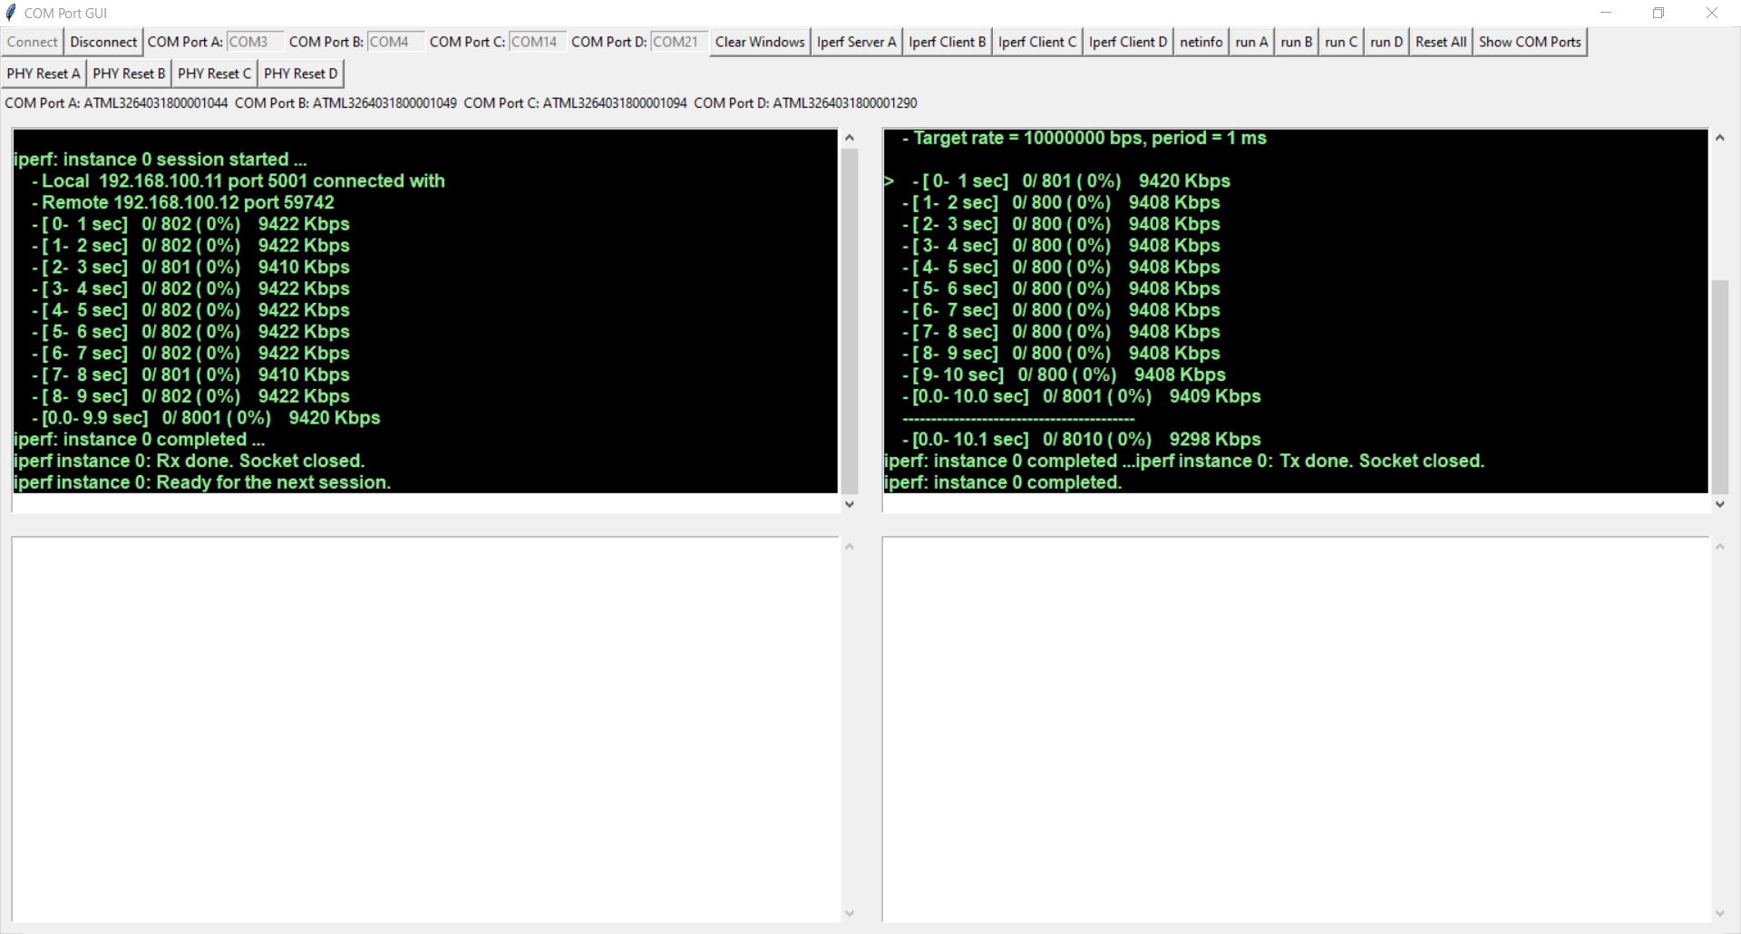
Python GUI for testing 4 Boards in parallel
A Bandwidth of approx. 9.4 Mbit/sec UDP traffic is achieved between two boards

Slide 23
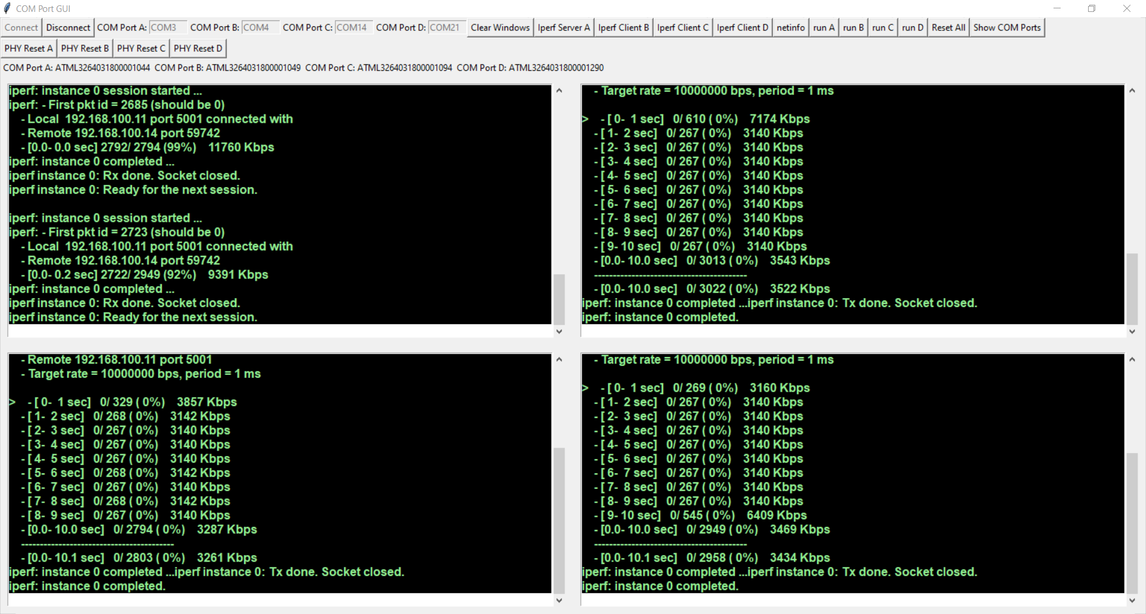
3 iperf client’s at the same time
A Bandwidth of approx. 3.1 Mbits/sec UDP Traffic is achieved when 3 iperf clients are running simultaneously

Slide 24
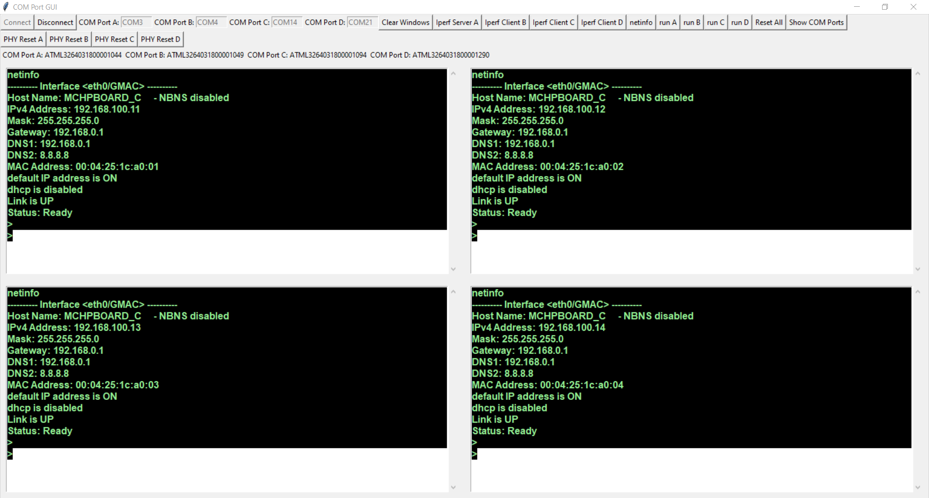
Sending the command “netinfo” to all boards
Pre defined commands can be send to one or more boards at the same time when a button is clicked.

Slide 25
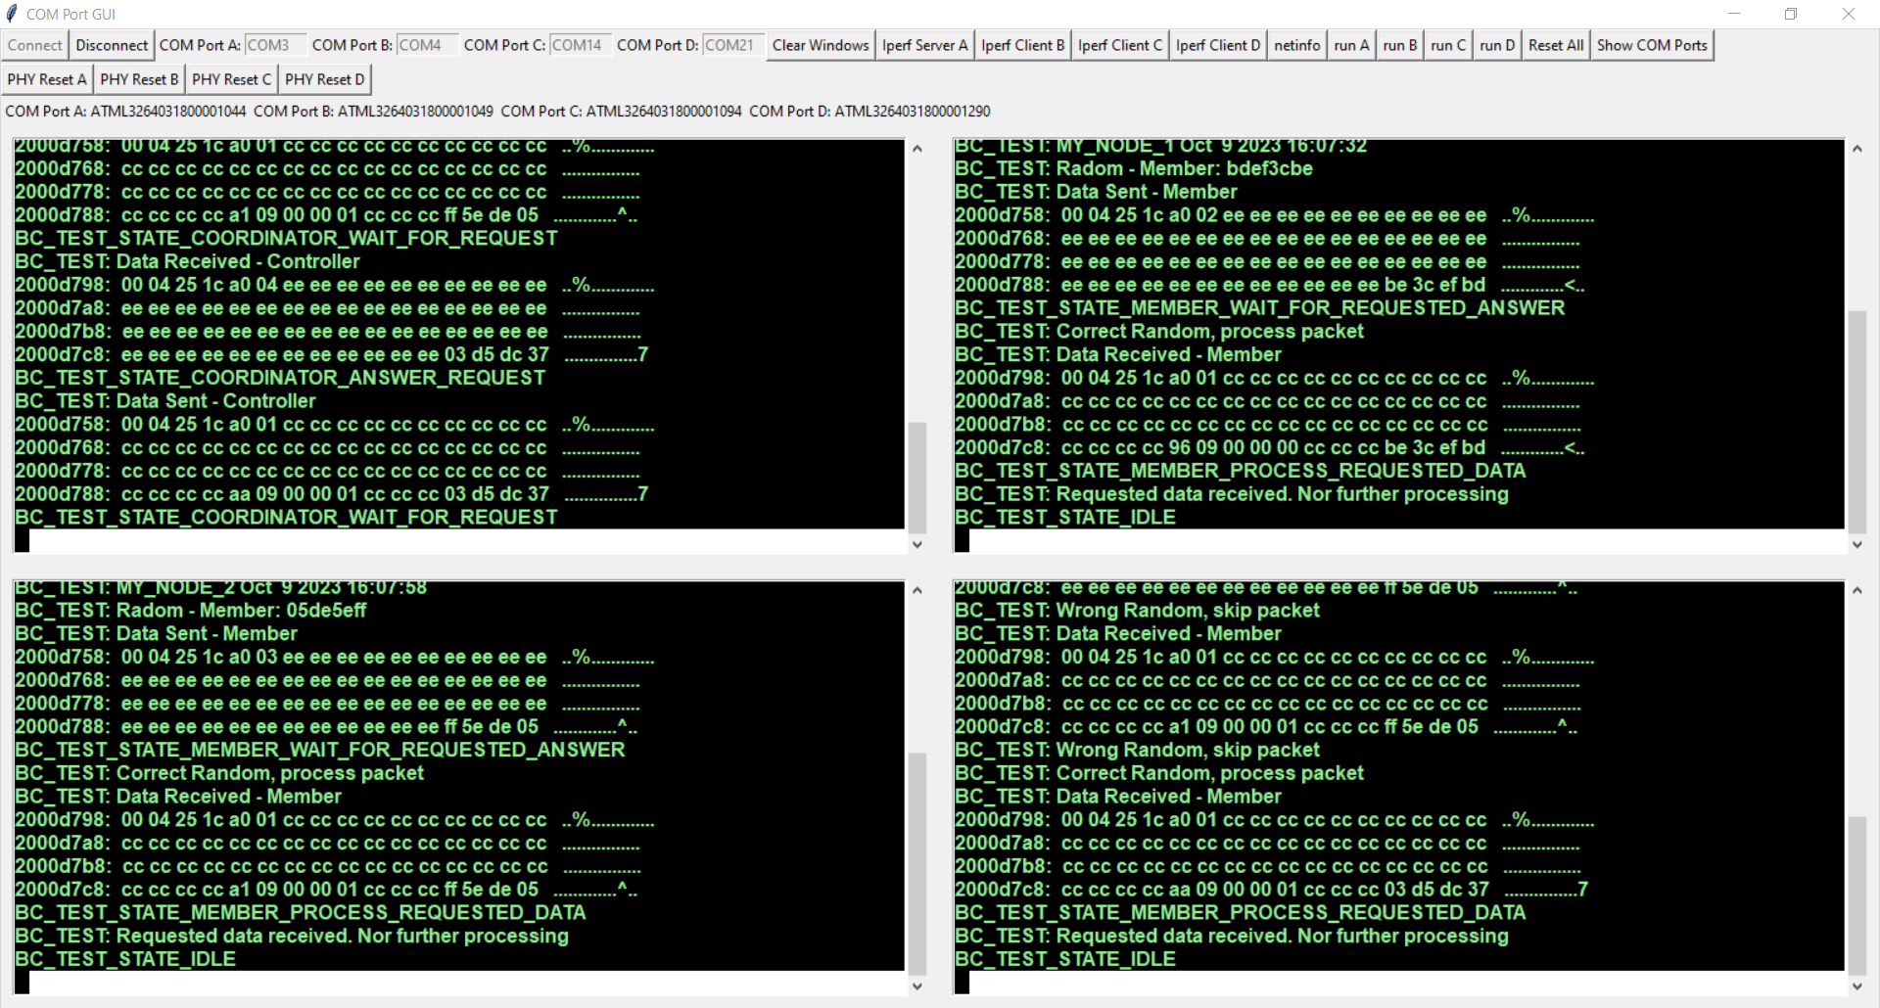
Testing UDP commucation between boards
When it comes to test communication protocols, the 4 terminals make it much more convenient to debug the firmware by locking into the output of the boards
This firmware starts with the command “run”, the sending of an UDP Broadcast packet. If until 5 secs there was no answer, the firmware decides to be the “COORDINATOR” which answers to such packets. Inside this UDP packets, a timestamp is also exchanged so that all Boards LED’s can blink synchronously every 2 secs

Slide 26
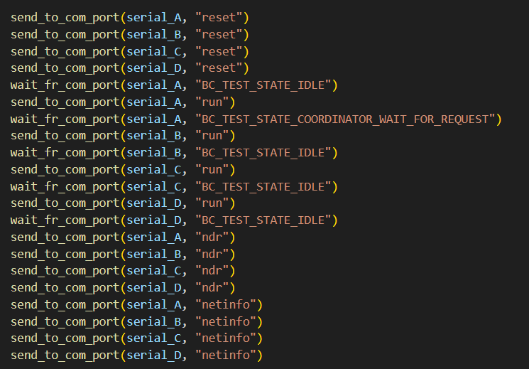
Test 1: Configure Boards Successive

Slide 27
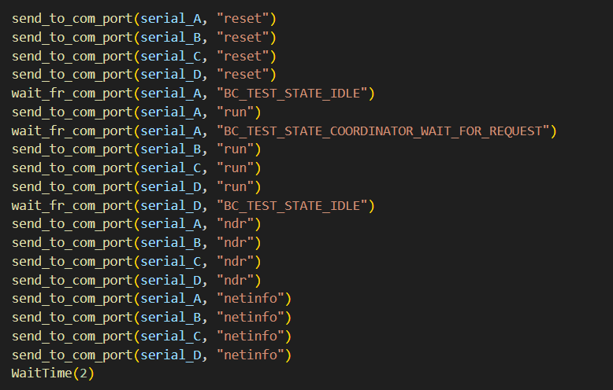
Test 1.2: Configure Boards Simultan

Slide 28
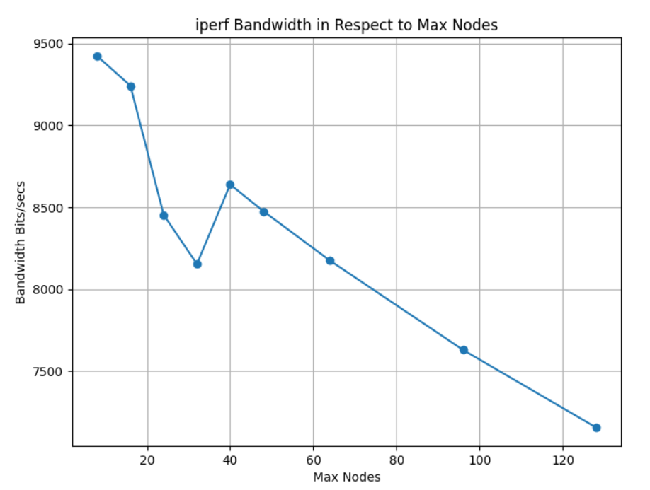
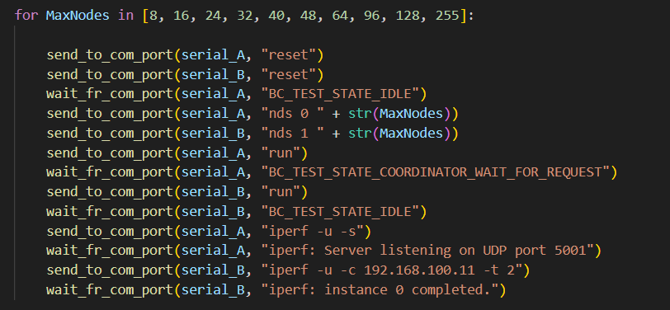
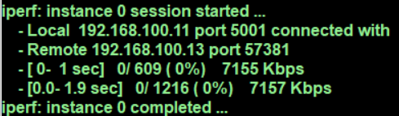
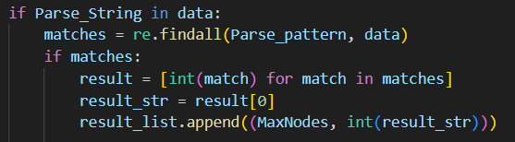

Test 2: iperf between two boards and varying the Max Nodes value

Slide 29
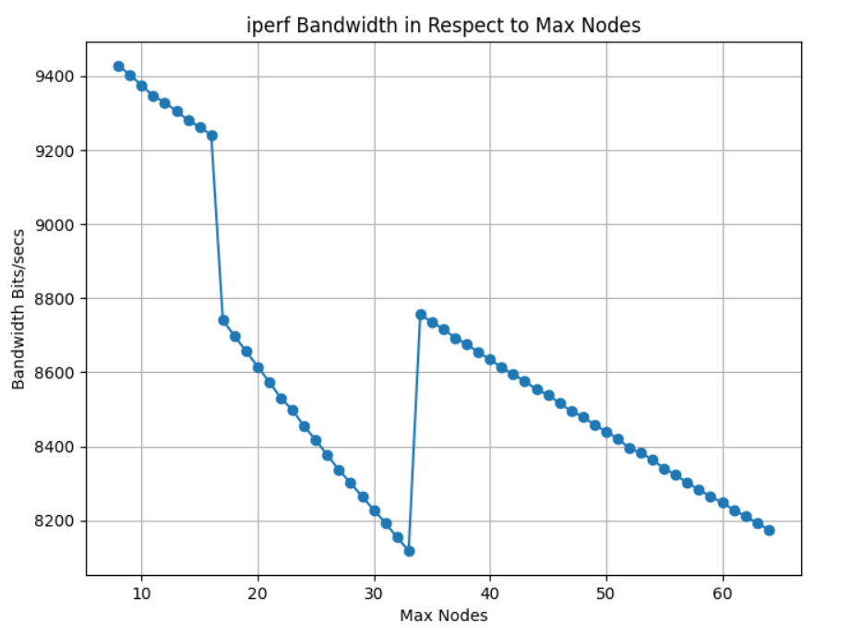

Test 2: iperf between two boards and varying the Max Nodes value

